Slide 1
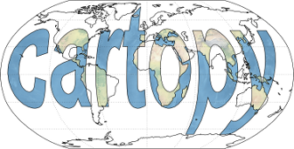
Python Cartopy Tutorial
Most people say: Car-toe-pie --- Alex Eddy says: Car-toe-pee
You decide!

Slide 2


Installing Cartopy
Anaconda is great with version control (*works best with bash shell)
You can install directly to your home directory at NSSL. (https://www.anaconda.com/products/individual#linux)
You can install several “environments” to support your code (e.g. python 2, python 3, basemap, cartopy, etc.)
For Cartopy: Create a new Anaconda environment and install using
  conda install -c conda-forge cartopy
Install Cartopy FIRST to avoid conflicts!
Always use the “conda-forge” channel

Slide 3
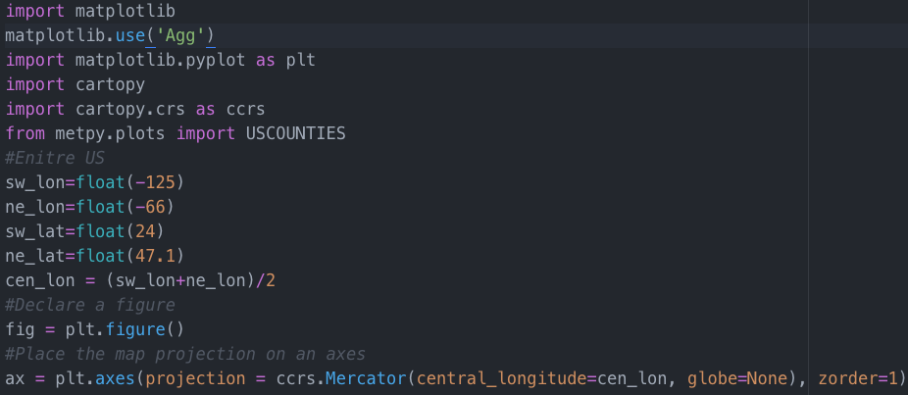
Setting up a Cartopy Map
← Import packages
Declare the domain bounds
Setup an empty figure and projection

Slide 4
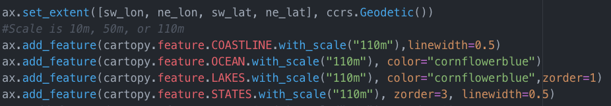
Setting up a Cartopy Map
set_extent – declares the boundaries of the map
Map Features:
  There are several map features you can add (https://scitools.org.uk/cartopy/docs/latest/matplotlib/feature_interface.html)
  Cartopy uses shapefiles from https://www.naturalearthdata.com/downloads/ so you can browse this site to see what features you want to use.
  If you don’t like these shapefile datasets… there are other datasets that work with Cartopy that you can use. I have not explored these options.
  The function (set_extent, add_feature, add_geometries, etc.) syntax is here: https://scitools.org.uk/cartopy/docs/v0.13/matplotlib/geoaxes.html
  Important Note: The first time you run Cartopy... It downloads these shapefiles on the fly so it runs really slow the first time (download time). The shapefiles are stored locally in Anaconda so later runs won’t take long.

Slide 5
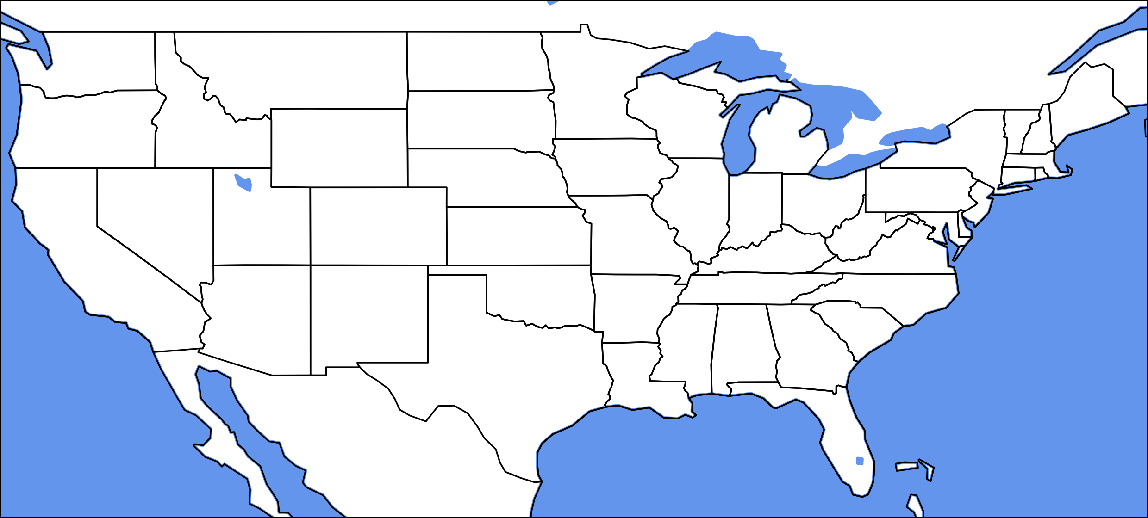
Projection = PlateCarree
This is the default projection in Cartopy
Pros:
  It plots the fastest
  It works great for quick/efficient mapping
  If you encounter mapping errors… use this projection and the problem will likely be fixed
Cons:
  I hate it
IMPORTANT NOTE: You should use this projection when plotting data to transform to Cartopy coordinates… regardless of your map projection https://scitools.org.uk/cartopy/docs/latest/tutorials/understanding_transform.html

Slide 6
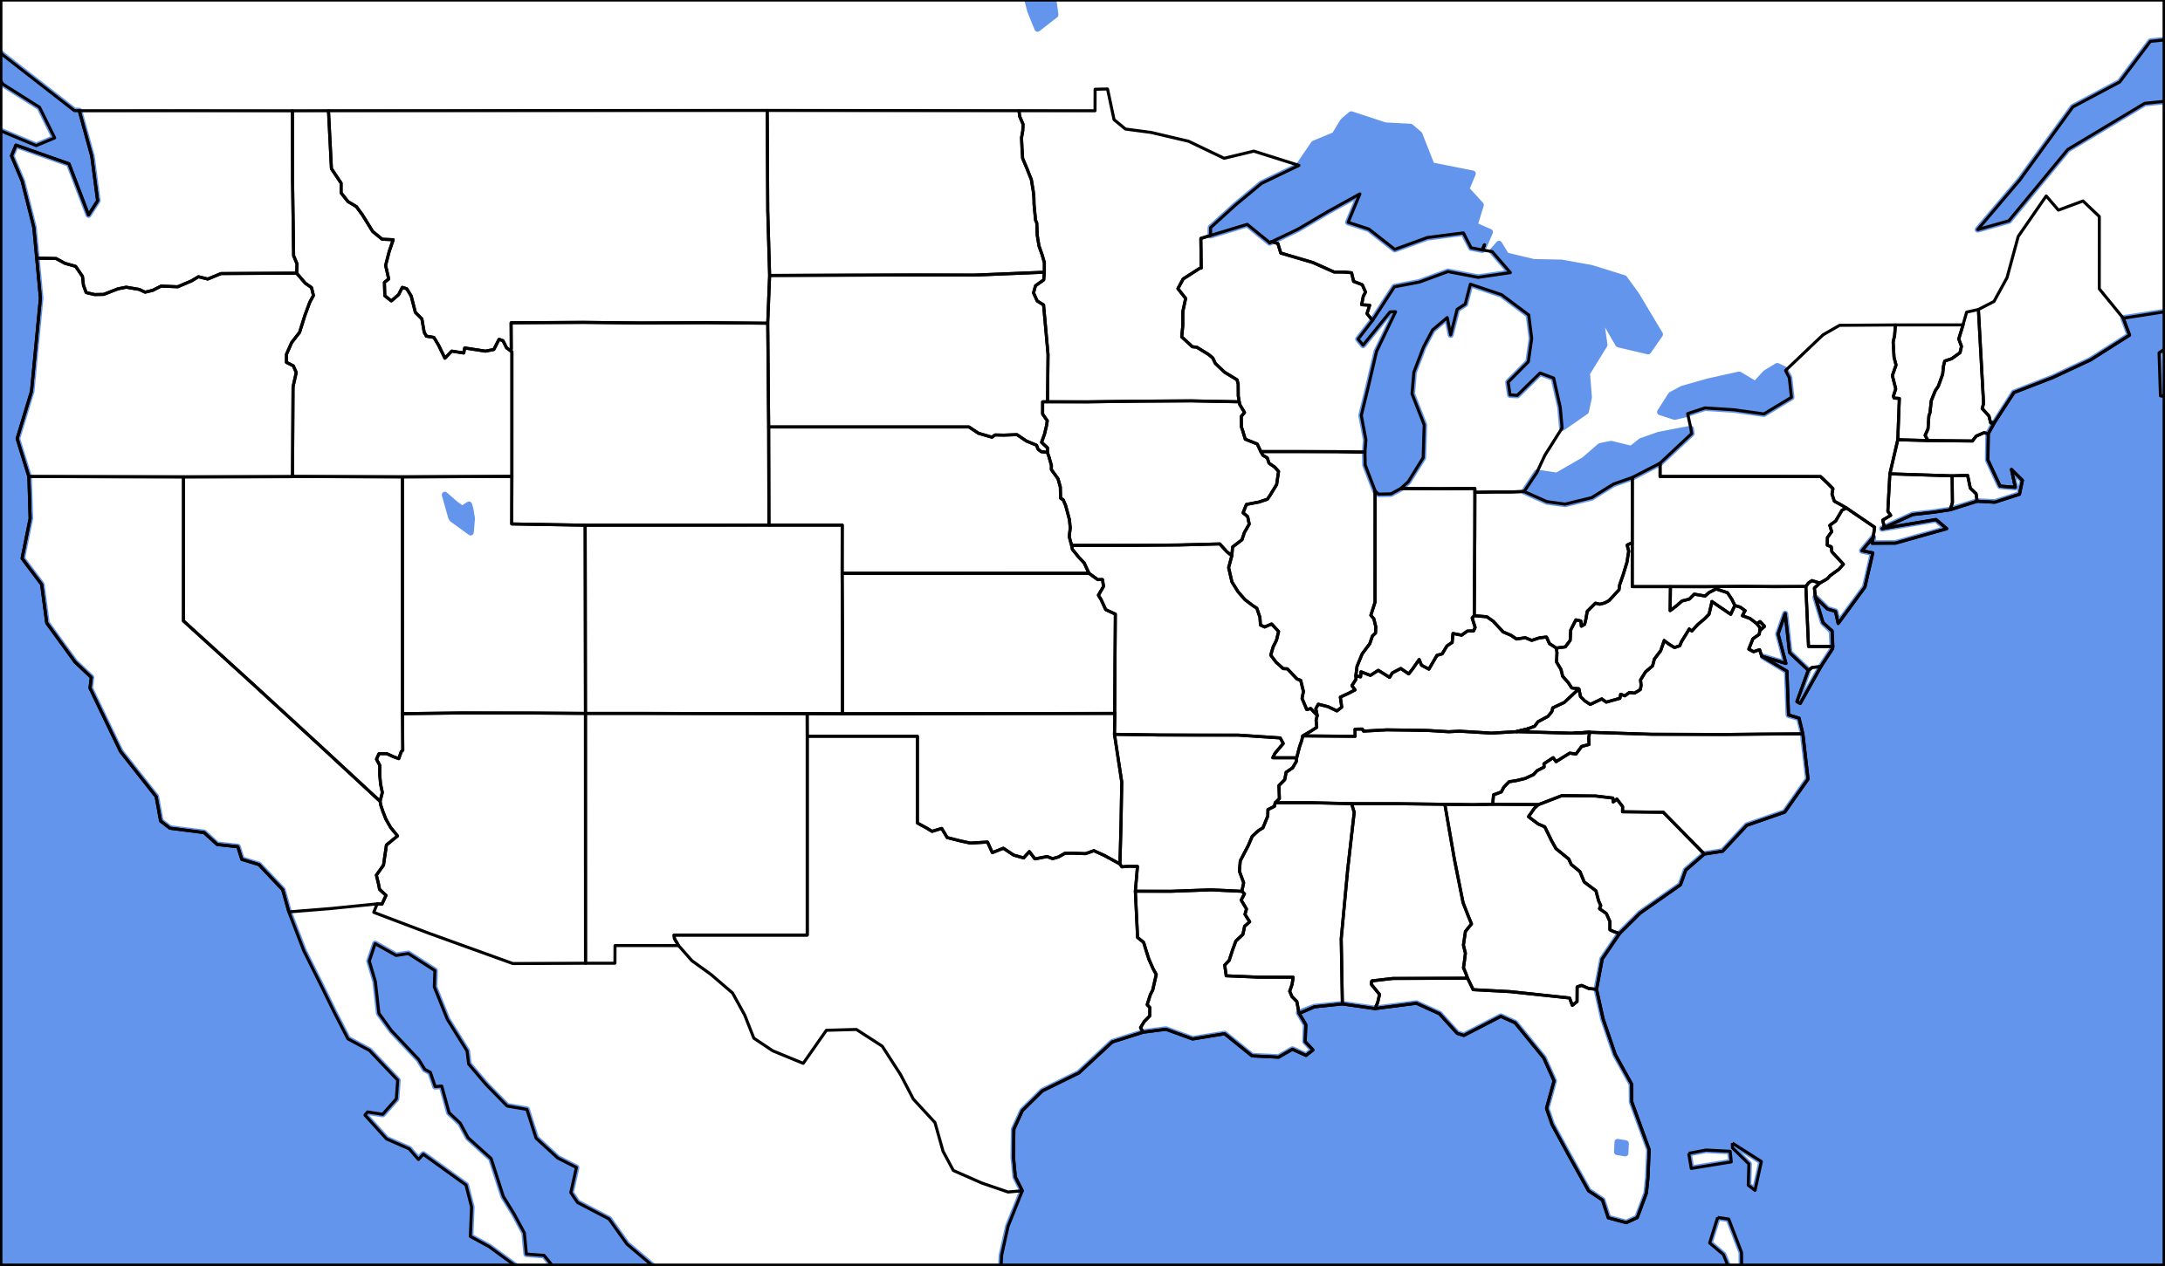
Projection = Mercator; Scale = 110m
My projection of choice and works well. You can find all of the projections here: https://scitools.org.uk/cartopy/docs/latest/crs/projections.html

Slide 7
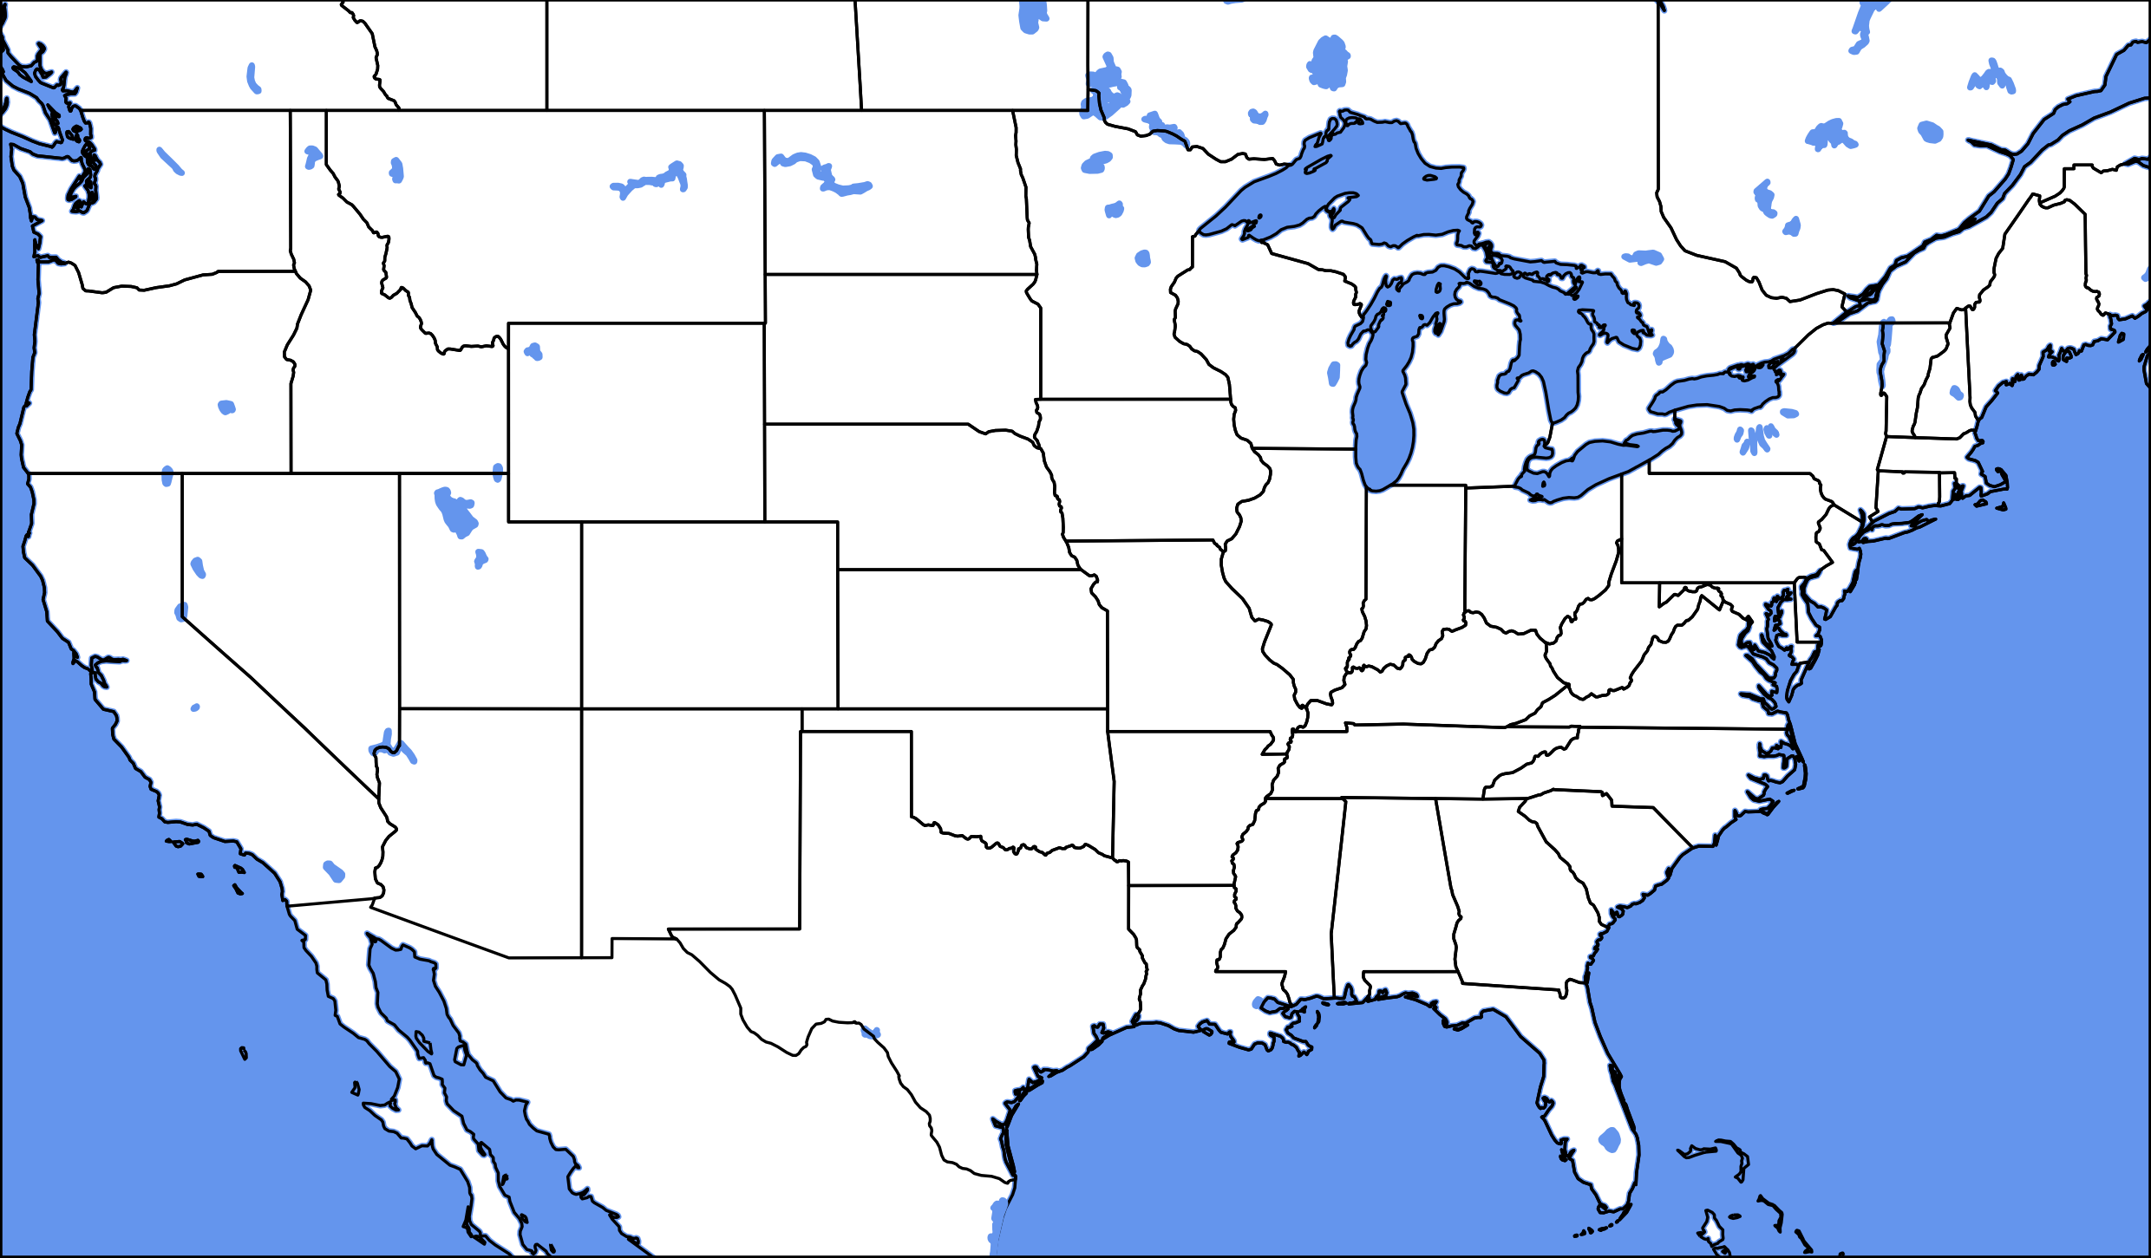
Projection = Mercator; Scale = 50m
My projection of choice and works well. You can find all of the projections here: https://scitools.org.uk/cartopy/docs/latest/crs/projections.html
As you increase the scale (e.g. resolution) computation time and file size increases.
I typically use 50m. It doesn’t cost much more and the map looks better. Adds detail in Canada/Great Lakes

Slide 8
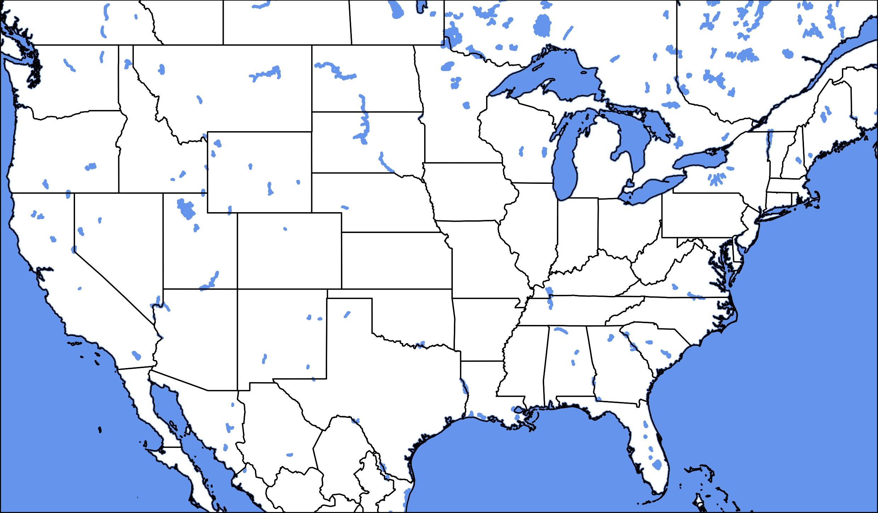
Projection = Mercator; Scale = 10m
My projection of choice and works well. You can find all of the projections here: https://scitools.org.uk/cartopy/docs/latest/crs/projections.html
As you increase the scale (e.g. resolution) computation time and file size increases.
I typically use 50m. It doesn’t cost much more and the map looks better. Adds detail in Canada/Great Lakes.
10m increases computational time significantly. You get too many lakes. Adds detail in Mexico.

Slide 9
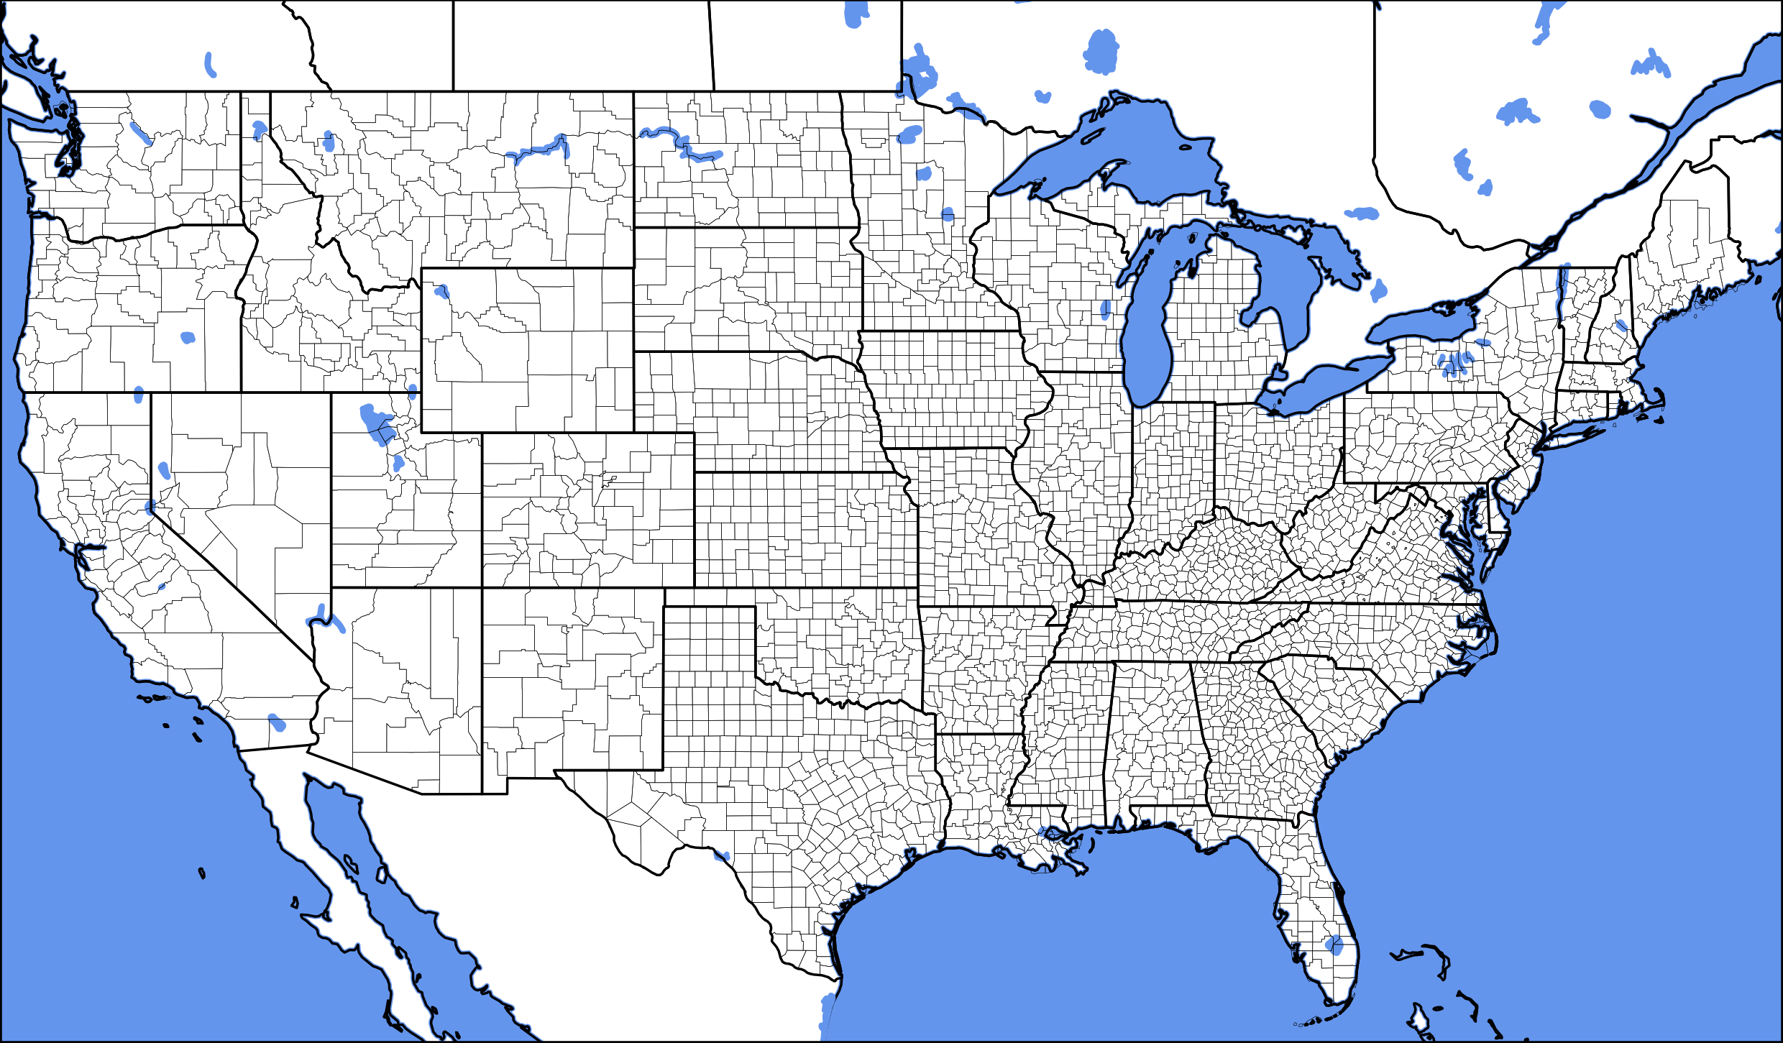
Projection = Mercator; Scale = 50m; Counties = 20m
My projection of choice and works well. You can find all of the projections here: https://scitools.org.uk/cartopy/docs/latest/crs/projections.html
As you increase the scale (e.g. resolution) computation time and file size increases.
I typically use 50m. It doesn’t cost much more and the map looks better. Adds detail in Canada/Great Lakes.
10m increases computational time significantly. You get too many lakes. Adds detail in Mexico.
MetPy interfaces well to plot counties, but at different resolutions. Increases computational time and file size.

Slide 10
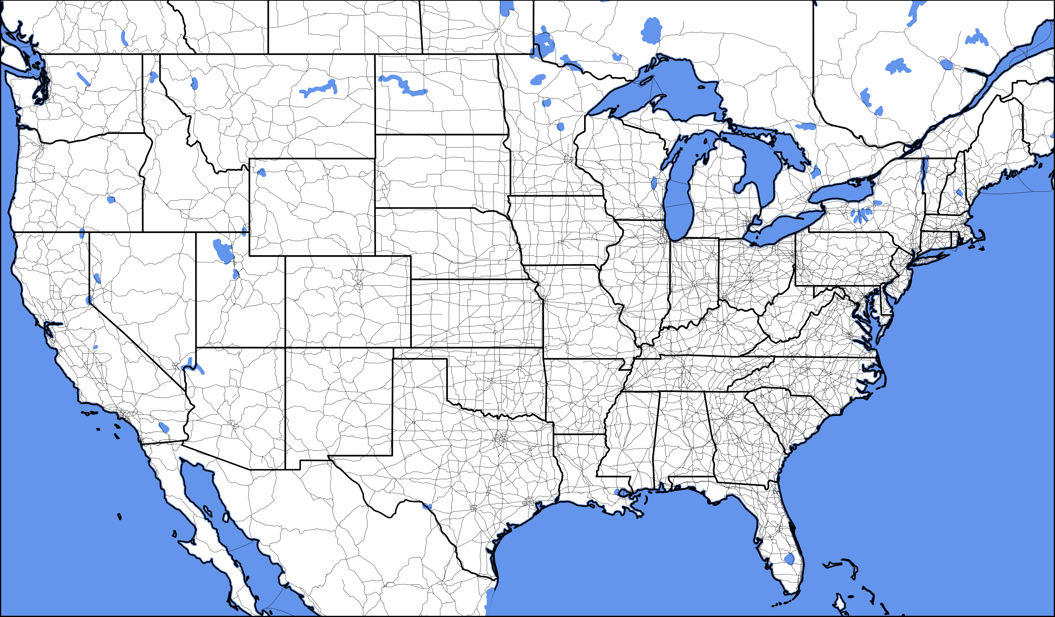
Projection = Mercator; Scale = 50m; Roads = 10m
If you want to add a Natural Earth shapefile feature you will have to look up what you want at this website. Here is the example of main highways: https://www.naturalearthdata.com/downloads/10m-cultural-vectors/
You may have to play with these a bit. For example: If facecolor is not “none”… then you get road blobs instead roads. The kwargs are from Matplotlib. You can find the syntax here for the cartopy side: https://scitools.org.uk/cartopy/docs/latest/matplotlib/feature_interface.html

Slide 11
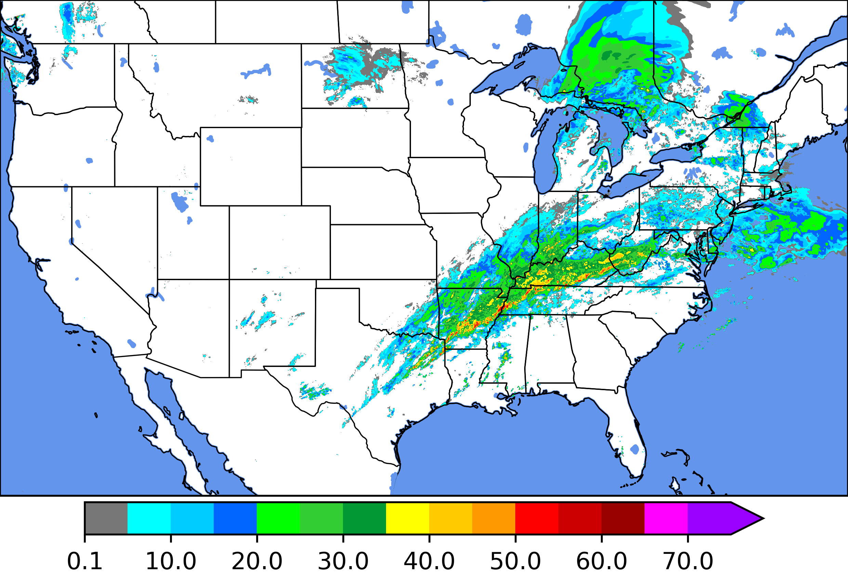
Plotting Data
Take the axis that you defined with the projection and use Matplotlib to overlay your data.
As mentioned earlier, You must transform the data to plot. You should use PlateCarree to transform the data because this assumes the data is in Lat/Lon grids. This will explain more: https://scitools.org.uk/cartopy/docs/latest/tutorials/understanding_transform.html

Slide 12
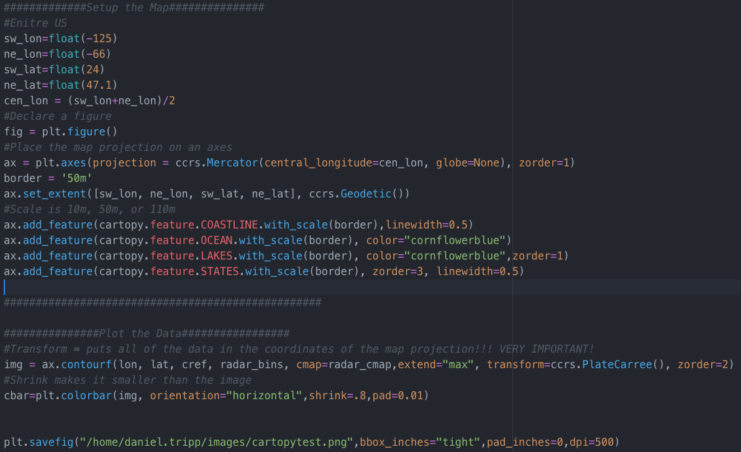

Slide 13
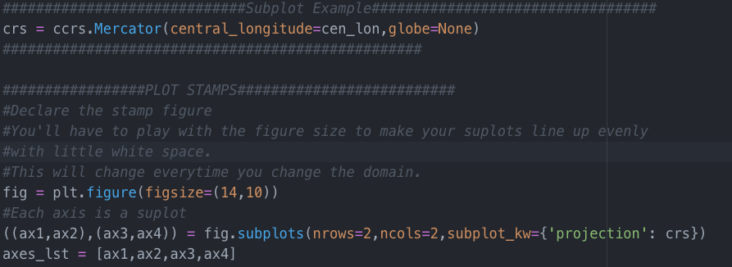
Plotting Data in Subplots
To setup the subplots, you follow the same logic. Just declare the same Mercator projection for every subplot axis. This is done using the ”subplot_kw={‘projection’: crs}” argument to pass the projection to each subplot axis. To plot data you would just preface contourf or contour with ”ax1.contour” to specify which subplot you are drawing on.

Slide 14
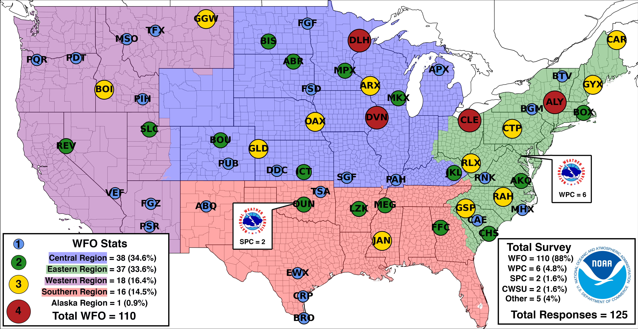
Plotting Shapefiles
If you want to add a shapefile you can use GeoPandas to open/process the files. They are easily plotted with Cartopy using the “add_geometries” function.
Here is an example of plotting the NWS regions. You can plot CWAs and all sorts of stuff pretty quickly using these 2 libraries (GeoPandas & Cartopy).

Slide 15
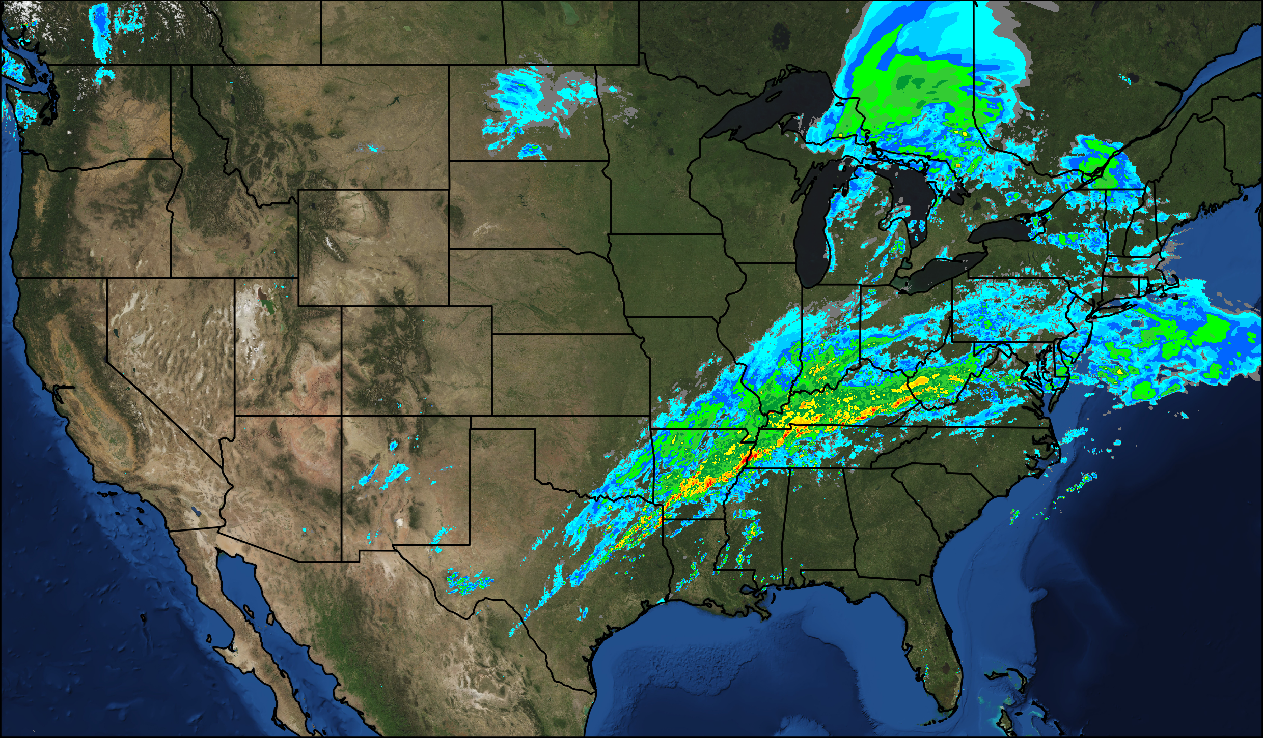
Plotting Fancy
If you need a really pretty map, Cartopy has the built-in functionality to pull imagery from online sources for your map. This is VERY computationally expensive but does make for a nice image. You can find the Cartopy documentation on this here: https://scitools.org.uk/cartopy/docs/v0.13/matplotlib/geoaxes.html
The code to add this map layer is just one line (below). **requires owslib package installation

Slide 16
Plotting Data Errors
TopologyException: side location conflict at -86.201911926269531 23.914173126220703
  This means that your data has some unique shape that caused contourf/shapely/cartopy to have a problem. This is a specific error attached to a geometric shape in your data.
Workarounds I’ve discovered:
  Change Projection (Probably to PlateCarree)
  Use Pcolormesh instead of contourf
  Include a try/except statement to avoid the code crashing
    Try: contourf() Except: pcolormesh()
If anyone figures out how to remedy this issue I’m all ears!

Slide 17
Resources
To generate the maps seen in this presentation (minus the shapefile image), see the following script: /raid/TAT/Daniel_Tripp/scratch/cartopy_tutorial.py
To download raw HRRR data: /raid/TAT/Daniel_Tripp/scratch/hrrr_download_dtobin.py
To plot HRRR data (netCDF) using Cartopy (single plots and subplot example): /raid/TAT/Daniel_Tripp/scratch/hrrr_plot_dtobin.py
The data and scripts will eventually be purged from this directory when I clean things out.
Disclaimer: There likely are better ways of using Cartopy… please share them with me when you figure them out. This will hopefully give you a good start!

