Slide 1
The Impact of Snow-to-Liquid Ratios on Ensemble Snowfall Decision Support
Andrew A. Rosenow, Daniel D. Tripp, Heather D. Reeves
Cooperative Institute for Severe and High-Impact Weather Research and Operations, The University of Oklahoma, and NOAA/OAR/NSSL, Norman, Oklahoma
Special Symposium on FACETs- Winter Weather
January 11, 2023 – Denver, CO

Slide 2
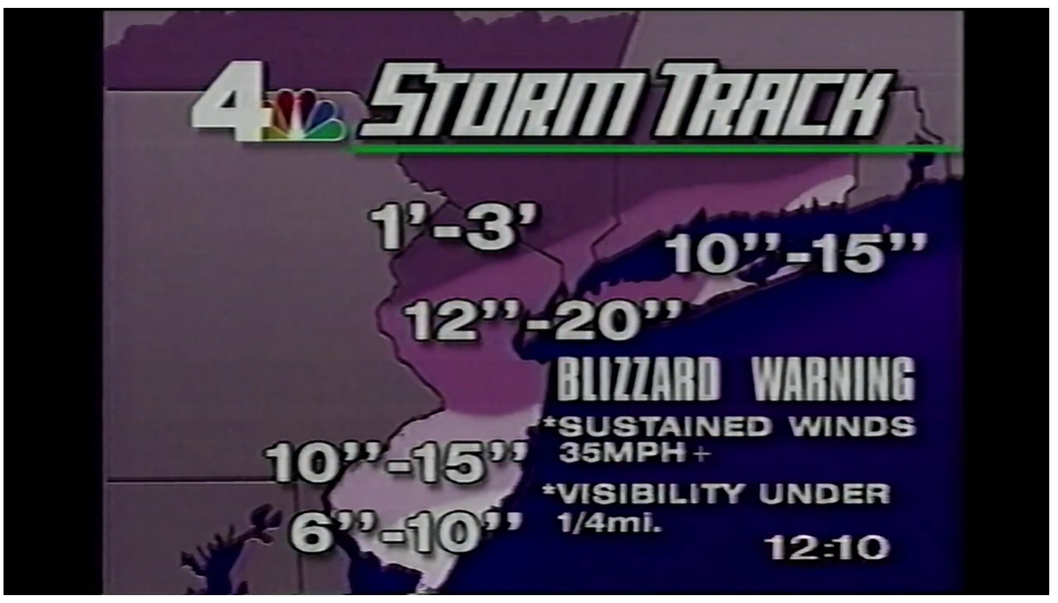
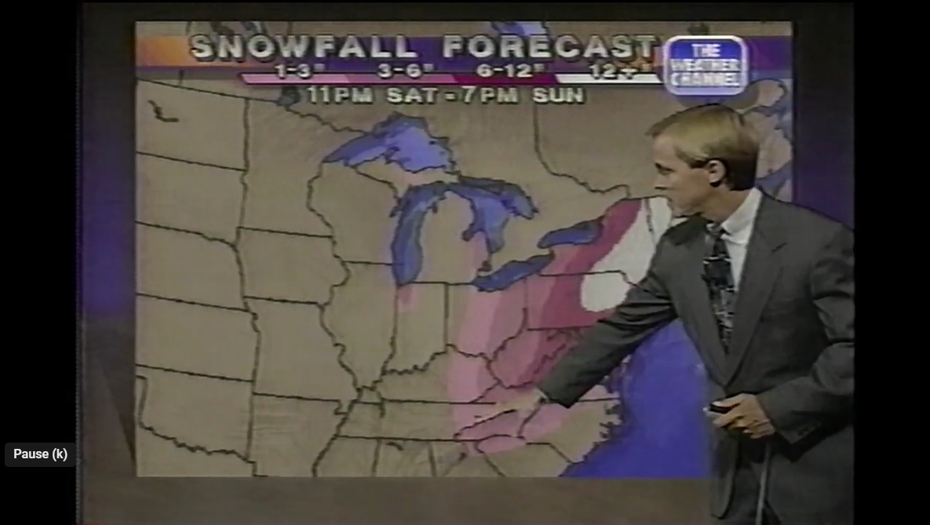
Forecasting Snowfall – Uncertainty in Public Forecasts
We’ve been expressing uncertainty in our winter forecasts for decades!
Video captures courtesy “Dad’s Weather Tapes”/YouTube

Slide 3
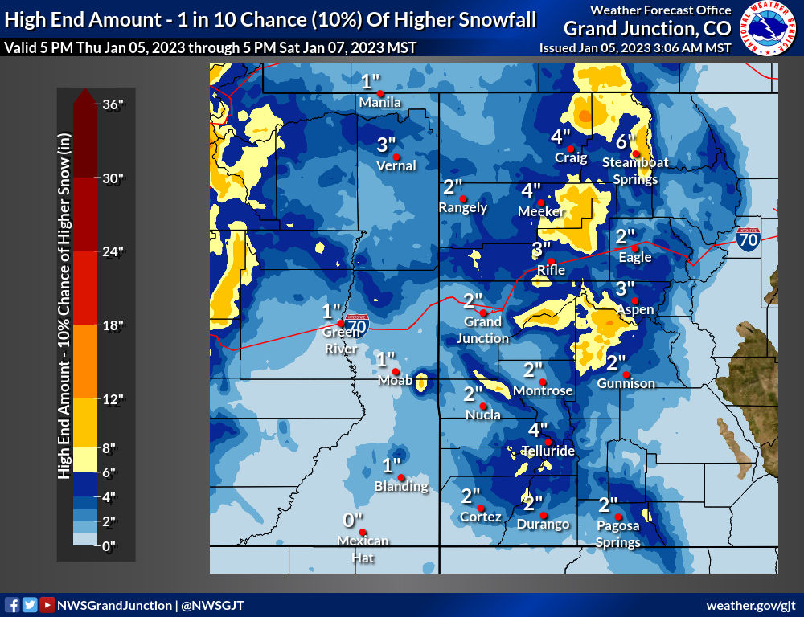
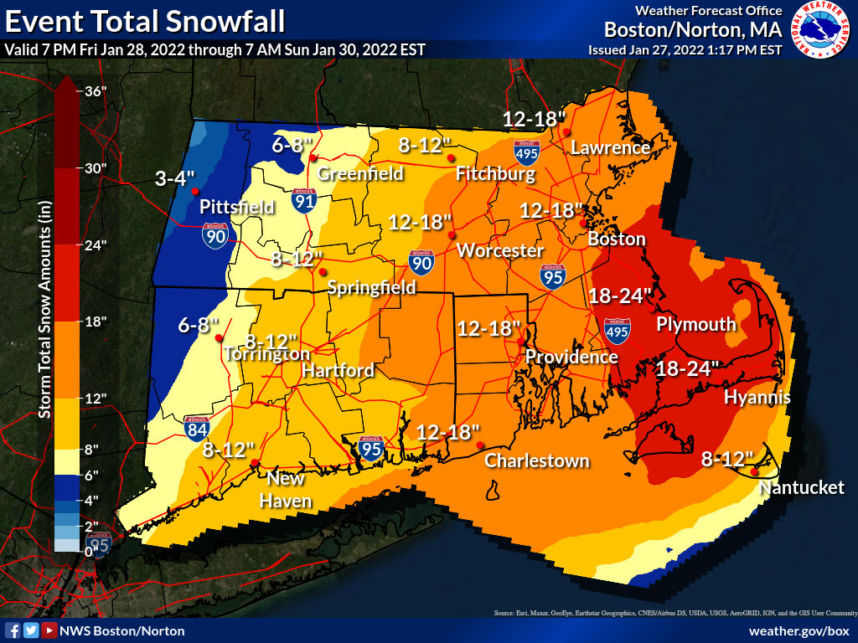
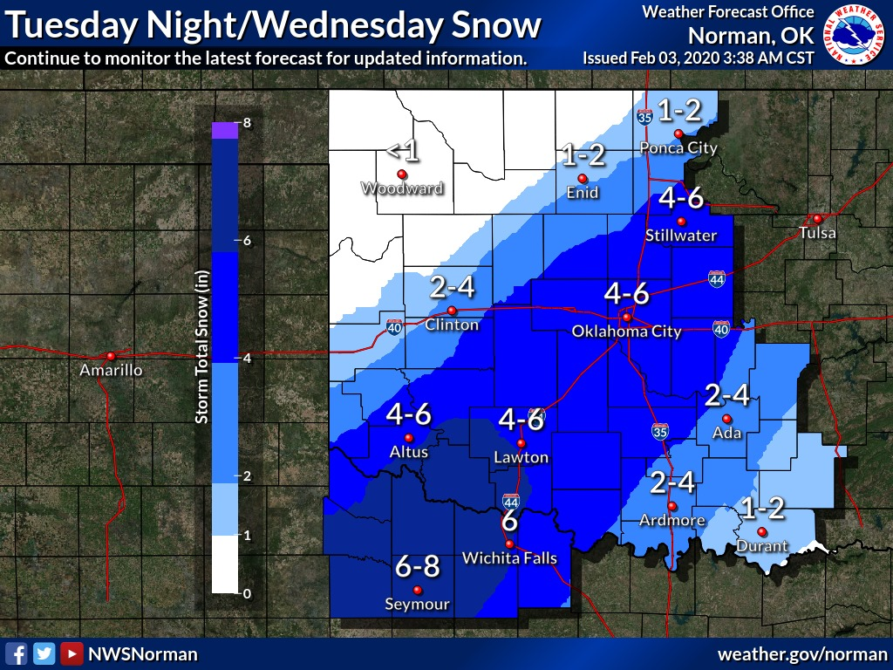
Forecasting Snowfall – Uncertainty in Public Forecasts
…but we’ve been expressing uncertainty (in mostly) the same way – a range of accumulations – for decades!
(Despite some attempts to introduce probabilities, including by NWS)

Slide 4
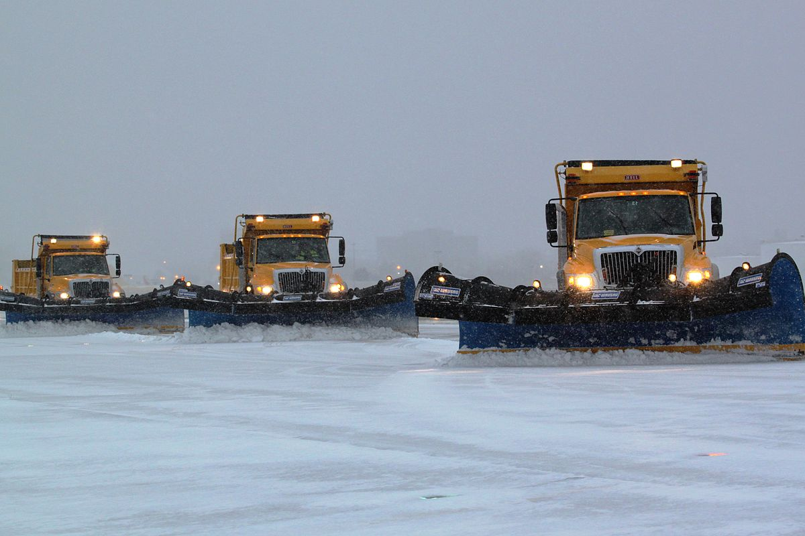
Enter the FACETs Paradigm
Rather than sticking with just accumulation, we want to give stakeholders the actual information they need
When does snow start? End?
When is the heaviest snow?
What is the worst/best case scenario?
Data (e.g. NWP) exists to produce impact-based decision support.
This effort is beginning (e.g. WSSI).
Snow seems like a logical place to start for purpose-built IDSS tools, but there’s a problem…
https://www.flickr.com/photos/kingair42/12289088955/

Slide 5
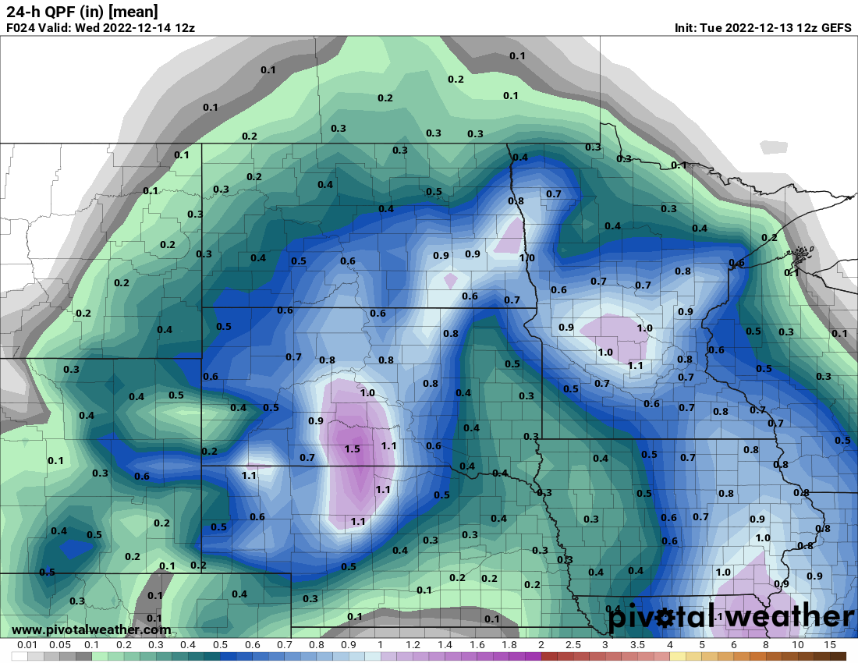
The Trouble with Snowfall
Models produce liquid QPF, not snow
We can translate QPF to snowfall using a precipitation type algorithm/model precipitation type to determine where snow fell
Then, use SLR to calculate snowfall
What SLR do we use?
Diagnosed SN

Slide 6
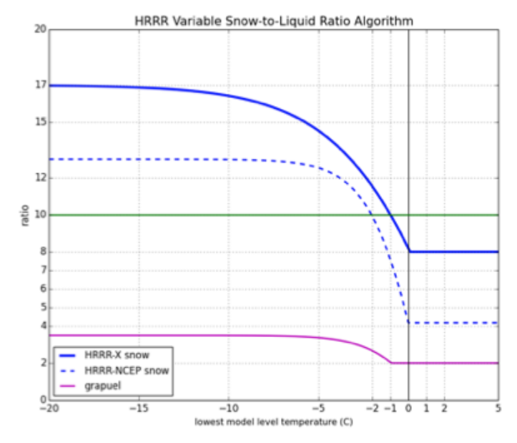
The SLR Problem
The motivation behind this project is to understand how SLR contributes to ensemble snowfall forecast errors
Can’t we just use model snowfall directly?
That can just hide SLR!
HRRR: SLR is a function of lowest model level Temperature
HRRR SLR for snowfall from NOAA Technical Memorandum OAR GSL-66

Slide 7
Study Methodology
Used HRRR-E Ensemble to produce hourly snowfall forecasts for 24 hour periods during five snow events, one forecast for each of these SLR methods:
10-to-1 Constant SLR
NOHRSC Climatology SLR
Kuchera Ratio (column-max Temperature method)
Cobb and Waldstreicher (2005) SLR method (vertical velocity method)
Verified forecasts against CoCoRAHS 24-hour snowfall observations
HRRR-E 24 hour period chosen to align with CoCoRAHS reporting days

Slide 8
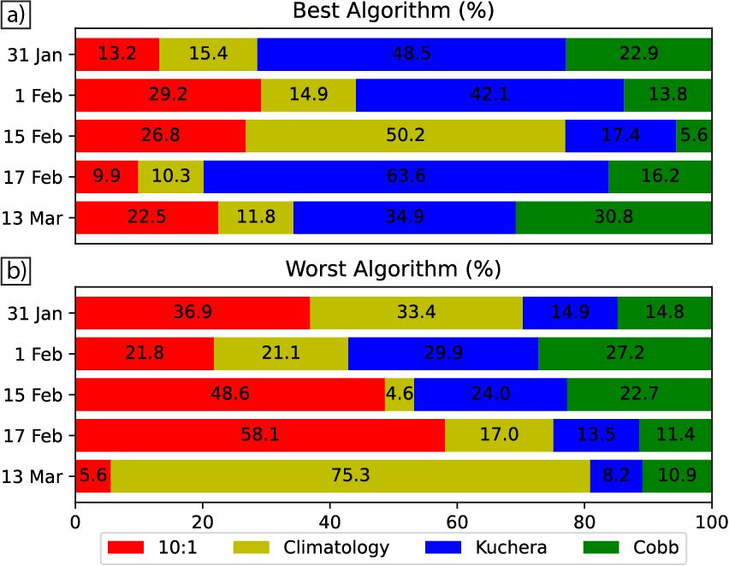
SLR Forecast Verification Summary
Verified every CoCoRAHS SN observation for each ensemble member/SLR combination
The “best” algorithm has the smallest forecast error, regardless of sign
Worst – largest error, regardless of sign

Slide 9
SLR Forecast Verification Summary
No clear “best” SLR relationship
See upcoming paper or my talk at last year’s AMS Annual for details…

Slide 10
Does adding HRRR snow forecast improve things?
No change to the story
HRRR mostly displaced Kuchera, as both are column-Temperature based
Without a dominant SLR, what happens when we use these to make probabilistic guidance?

Slide 11
SLR and Probabilistic Forecasting
Create probability of exceedance graphics using the 9 members for each SLR
Example: Probability of 24 hr. snowfall > 101.6 mm
Data from 1 Feb 2021

Slide 12
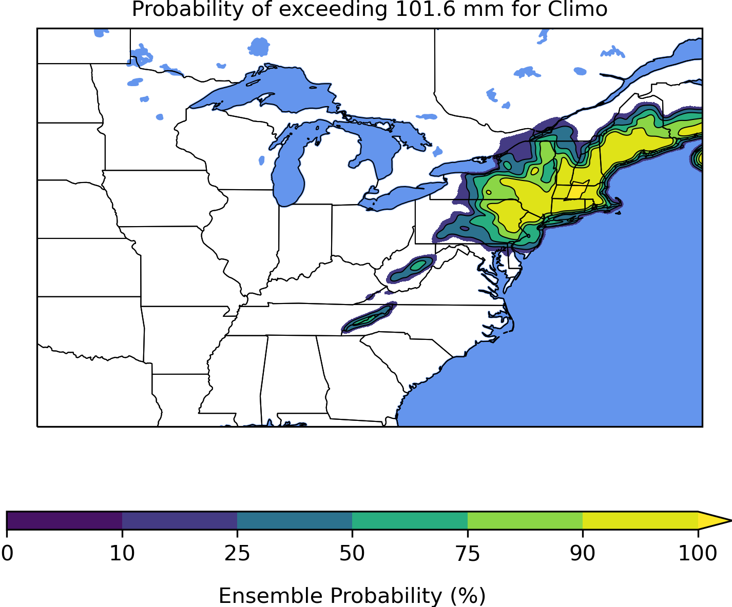
How does SLR change exceedance probabilities?
With no changes other than SLR, probabilities increase by 10+% in the NW part of the snow swath, and decrease 10-20% near the Atlantic coast going from Climo to Kuchera.

Slide 13
Does this difference matter?
Created hourly snow rate forecasts for stations
Here: Boston, MA
The mean snow rate from the five SLRs is plotted in color
Top and bottom lines are max and min rate from any SLR at that hour
Black line at 25.4 mm hr⁻¹ represents a hypothetical decision point

Slide 14
Different SLRs = Different Decisions
The Cobb, 10:1, and Climo means go above the decision point by hour 4, and back below by hours 11-12
Kuchera mean is only above from hours 6-9
HRRR mean never goes above the critical snow rate

Slide 15
Different SLRs = Different Decisions
This plot is identical, except it is for Knox County Regional, ME
A stakeholder interested in the time with the heaviest snow rate would be told hour 12 for the Cobb SLR, and 14 for the rest
HRRR SLR never exceeds critical snow rate

Slide 16
Different SLRs = Different Decisions?
Next: Manchester-Boston Regional (NH)
Here, a product using the means of the various SLRs wouldn’t be significantly different
Slightly different end hour
Still have large spread between the absolute ends of the distribution!

Slide 17
Conclusions
Email: andrew.rosenow@noaa.gov
As with deterministic forecasting, Snow-to-Liquid ratio is a crucial problem for developing decision support
Impacts maxes, means, duration, etc.
Changing SLRs alone is enough to change guidance from a decision support tool
This would be exacerbated if different models use different SLRs
Several possible future avenues to address this:
Can we choose best SLR based on geography/meteorological regime?
Likely will be at the regional/mesoscale level
Should we use multiple SLRs to create ensemble probabilities?
Authors acknowledge support under NOAA grants NA19OAR4590230 and NA21OAR4320204.

